Slide 1


Web scraping to gain company insights
11th of April 2024 Created by: Duneesha Suloshini

Slide 2
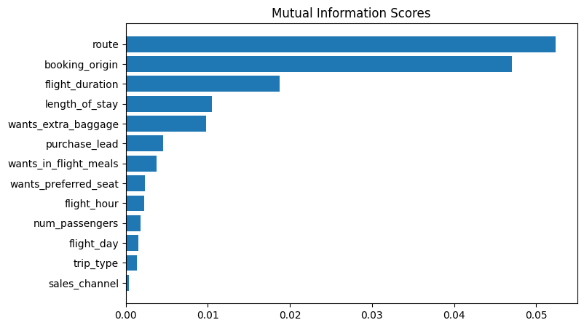
Predictive model to understand factors that influence buying behavior
We have trained the data set with Random forest classifier model and received
ACCURACY: 85.59
AUC score: 0.558
The graph illustrates the top features
which influence
Customer buying behavior
We need to increase the AUC score.

